Slide 1

PRESENTATION
TOURICE
TEAM MEMBERS:-
VIDHI GOYAL (201500781)
SHUBHI AGARWAL (201500682)
PRIYA SENGAR (2115990014)
ANVESH MANGALAM(201500133)

Slide 2
TOURICE
A tour and travel website should provide comprehensive and engaging content to attract potential customers and help them plan their trips. Here are some ideas for content that could be included on such a website:
Destination Guides: Provides detailed information about popular tourist destinations, including attractions, activites, culture, history and local cuisine.
Travel Tips: Offer practical advice and tips on everything from packing to booking flights and accommodations. Share insights on customs and etiquette, safety precautions, and transportation options in different countries.
Travel Stories: Share inspiring and engaging stories from real travelers about their experiences, adventures, and discoveries. This can help inspire others and give them a sense of what to expect when they travel.
Accommodation Reviews: Provide detailed reviews of hotels, resorts, and other types of accommodation. This can help travelers make informed decisions about where to stay and what amenities to expect.

Slide 3
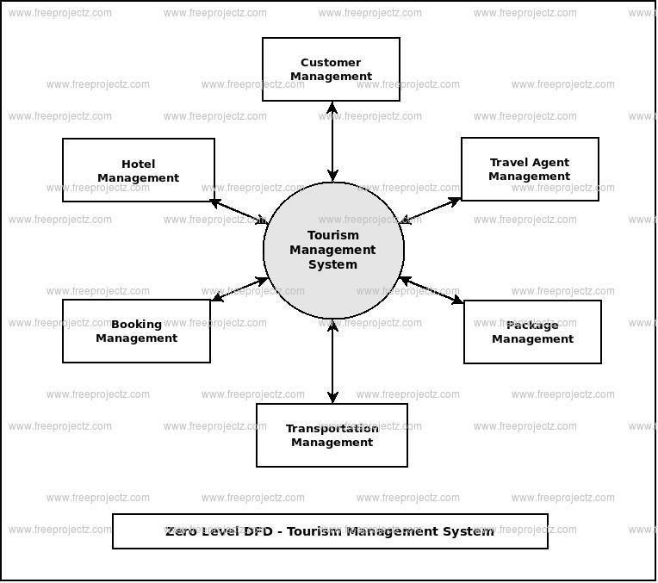
5. Food and Drink Guides: Offer recommendations and reviews of local restaurants, cafes, bars, and food markets. This can help travelers discover new foods and experience local cuisine.
6. Travel Photography: Showcase stunning photos of different destinations, landmarks, and attractions. This can help travelers visualize their trip and get excited about their upcoming adventure.
7. Travel Videos: Create engaging and informative videos that showcase different destinations and experiences. This can help travelers get a better sense of what to expect and inspire them to book a trip.

Slide 4
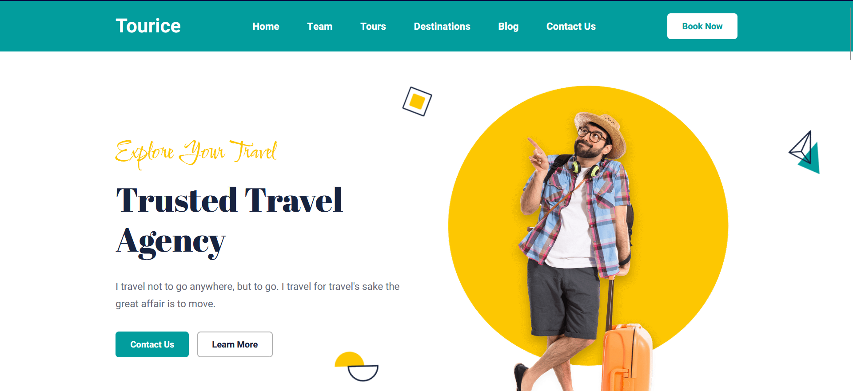
HOME PAGE
Are you dreaming of a vacation but don't know where to start? Look no further! At Tourice, we are passionate about travel and committed to helping you create unforgettable memories.
Explore the world with us!
We offer a wide range of travel packages to suit every taste and budget. From exotic beaches to cultural heritage sites, from adventure sports to wildlife safaris, we have something for everyone. Our packages are customizable to meet your specific needs and preferences.

Slide 5
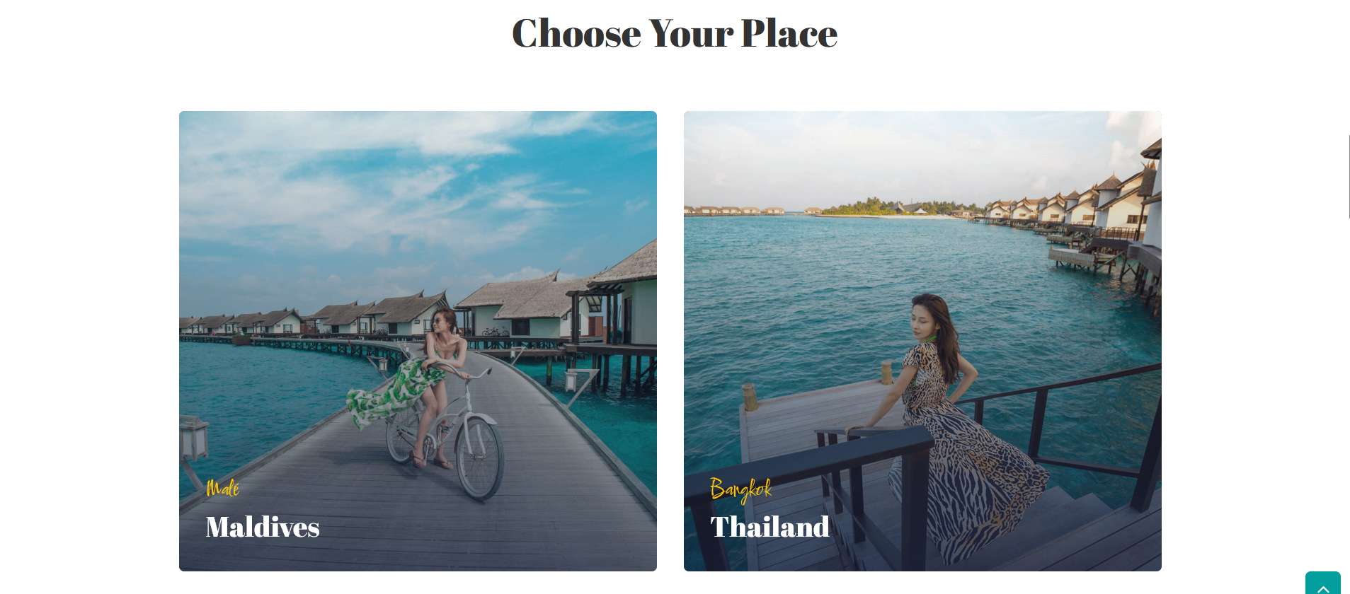

DESTINATION PAGE
Explore the World with Tourice
At Tourice, we offer travel packages to some of the most beautiful and exotic destinations in the world. From the breathtaking natural wonders to cultural heritage sites, our destinations are handpicked to provide an unforgettable travel experience

Slide 6
Here are some of the destinations we offer:
Bali, Indonesia
Bali is a tropical paradise that offers a perfect blend of relaxation and adventure. From the stunning beaches to the lush green forests, Bali has something for everyone. You can explore the cultural heritage of Ubud, visit the stunning temples, or simply relax on the beach and soak up the sun.
Santorini, Greece
Santorini is a picture-perfect destination that offers breathtaking views of the Aegean Sea. With its whitewashed buildings, blue-domed churches, and cobblestone streets, Santorini is a romantic paradise. You can enjoy a sunset cruise, visit the ancient ruins, or simply stroll around the charming villages.
Machu Picchu, Peru
Machu Picchu is an ancient Incan city that is a UNESCO World Heritage Site. The site is located high in the Andes Mountains, and the journey to reach it is an adventure in itself. You can hike the Inca Trail, visit the historic cities of Cusco and Lima, and explore the rich culture and history of Peru.

Slide 7
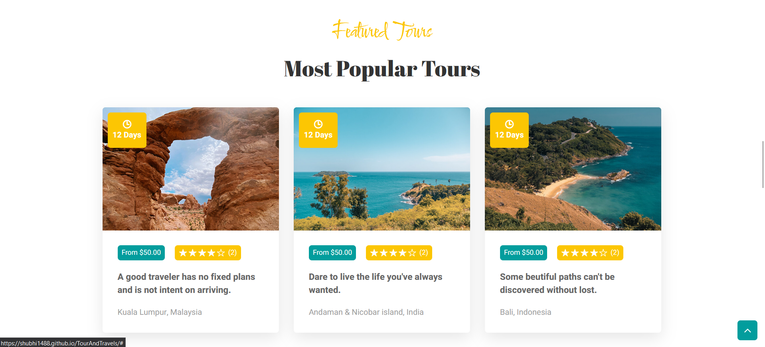
FEATURED TOURS
Welcome to our Tour section! we offer a wide range of travel packages to suit every taste and budget. Whether you're looking for a romantic getaway, a family vacation, or an adventure-filled trip, we have something for everyone. Our travel packages cover some of the most popular destinations across the globe, as well as some hidden gems that are off the beaten path.
From tropical beaches to snow-capped mountains, from bustling cities to tranquil countryside, we have it all. So, whether you're planning a solo trip, a romantic getaway, or a family vacation, we've got you covered. Check out our travel packages and start planning your next adventure today!

Slide 8
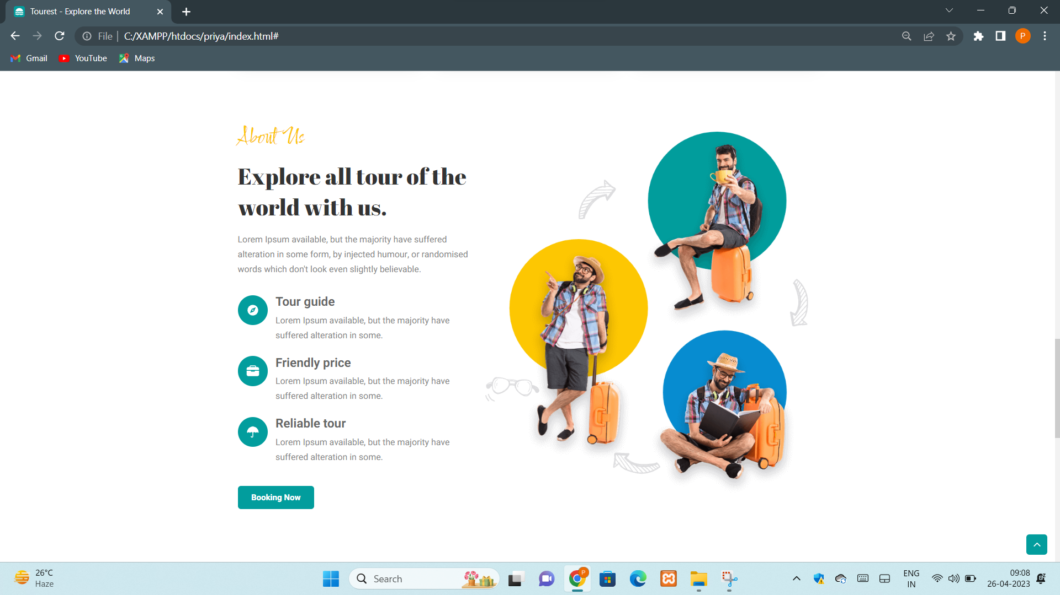
ABOUT US
This is the about us page which tells the users about our website in brief and help them to Connect with the people who has developed the platform for them to make their journey Filled with excitements and adventures.

Slide 9
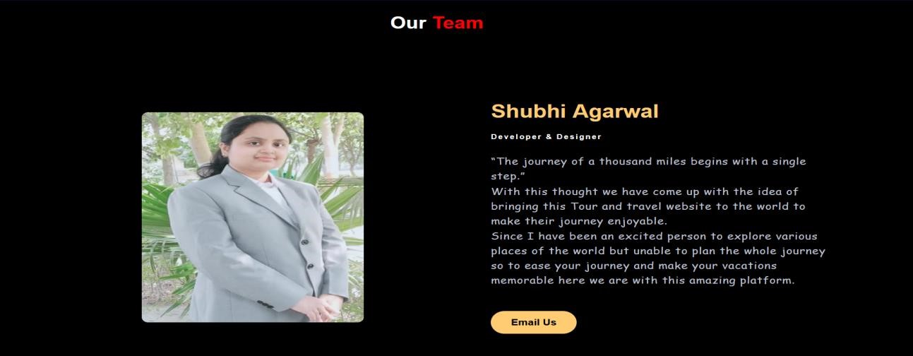
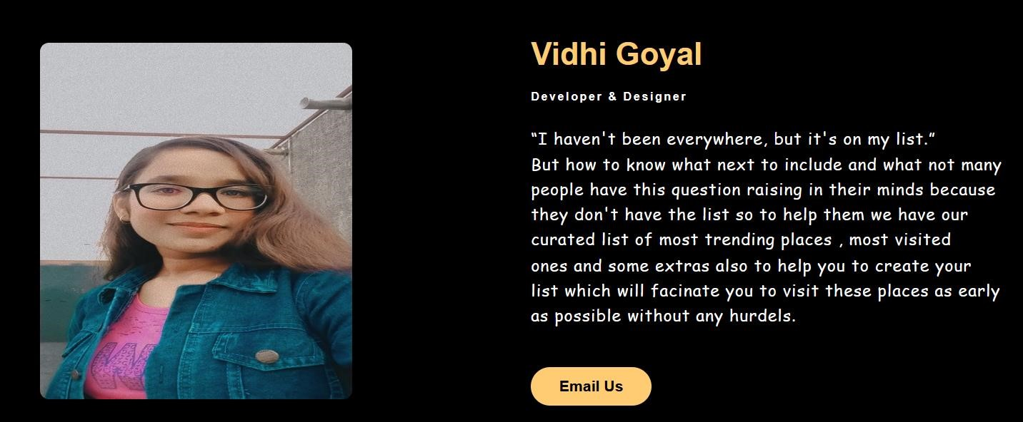

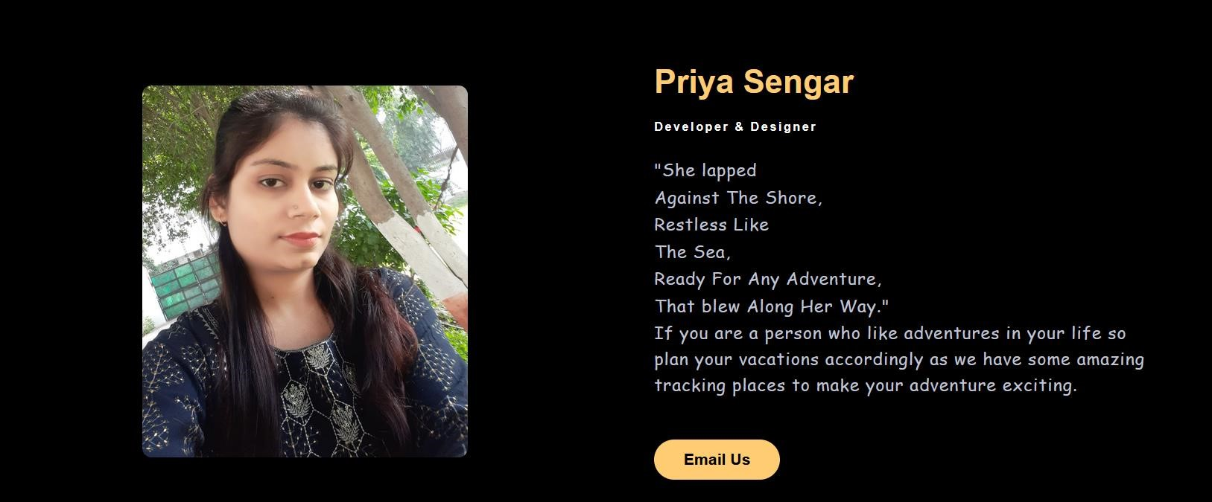
OUR TEAM

Slide 10
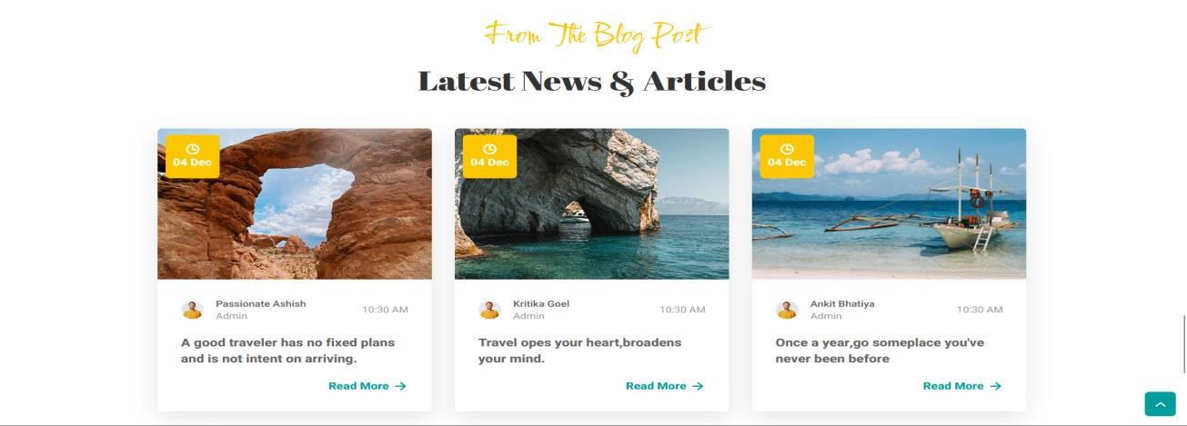
BLOGS
This newsletter and blog section contains the places where our website had featured in past few months and various travelers posting their blogs or short videos from the destinations which they have visited and recommending us to other users also.

Slide 11

BOOK NOW
Through this users can send us their details and we will send complete details of their package and the payment details too
Provided they have submitted the correct personal details.

Slide 12
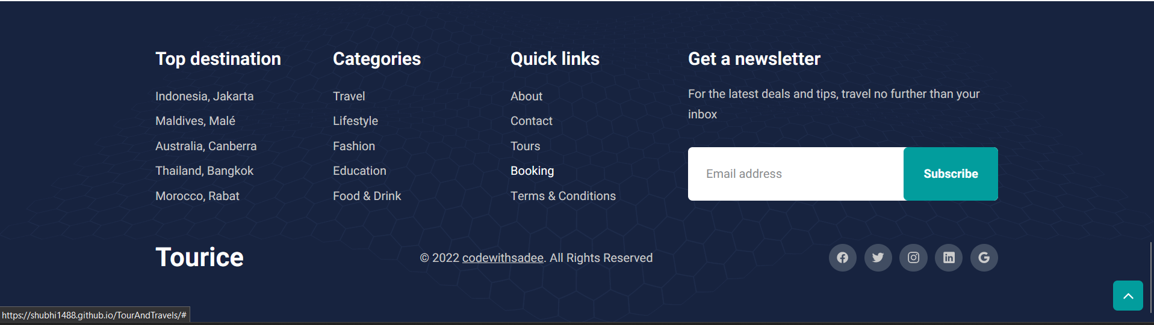
FOOTER
This is the footer section or we can say this section is a summary section which have the quick links to the sections of the website to make users easily navigate through them and it also have a subscribe button to send us your experience and share us your own fascinating journey with us and do follow us on our social handles mentioned in this section.

Slide 13

References-
www.javatpoint.com
www.geekforgeeks.com
Github link:- https://shubhi1488.github.io/TourAndTravels/
Faculty Guidence-
MR.BHANU KAPOOR (Technical Trainer)

